Slide 1
Microsoft 365 & Power Platform Development – Bi-weekly call
Your host in this call: David Warner (Microsoft)
August 18th, 2022

Slide 2



v
Agenda
Latest Updates on community
PnP .NET libraries
PnP PowerShell
Independent Publisher Connectors
Latest on script samples
Latest Microsoft Teams samples
Latest on Power Platform samples
Picture time with the Together Mode!
Mitanshu Garg - Independent Publisher Connectors - RegEx Matching Demo
Chris Kent - List Formatting Magic – Data and Time formatting options

Slide 3
Opportunities to Participate in the community
Demo solution or technical pattern
Contribute on GitHub
Provide feedback
Great opportunity to get visibility for you or your company. Demo sample or explain how you extend or customize SharePoint Online with live demo in your projects. Reach out to team for volunteering.
Request a demo spot on the call
https://aka.ms/m365pnp/request/demo

Slide 4
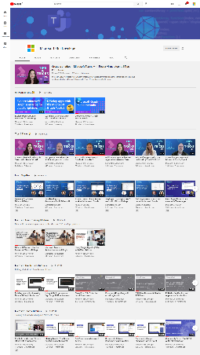
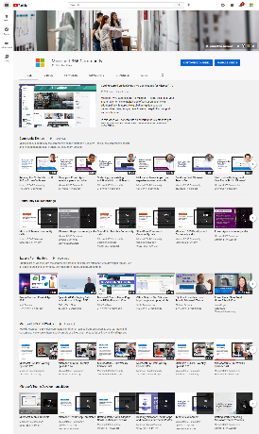
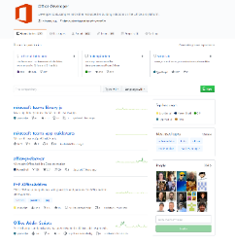
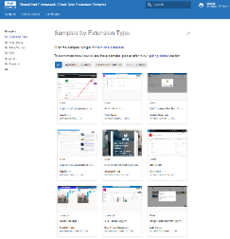
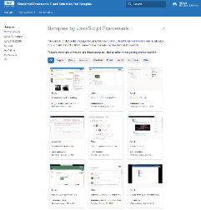
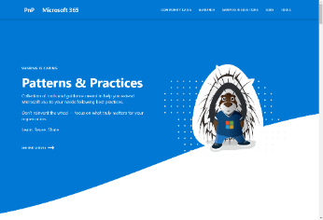
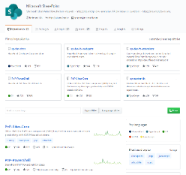
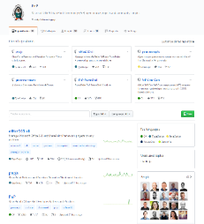
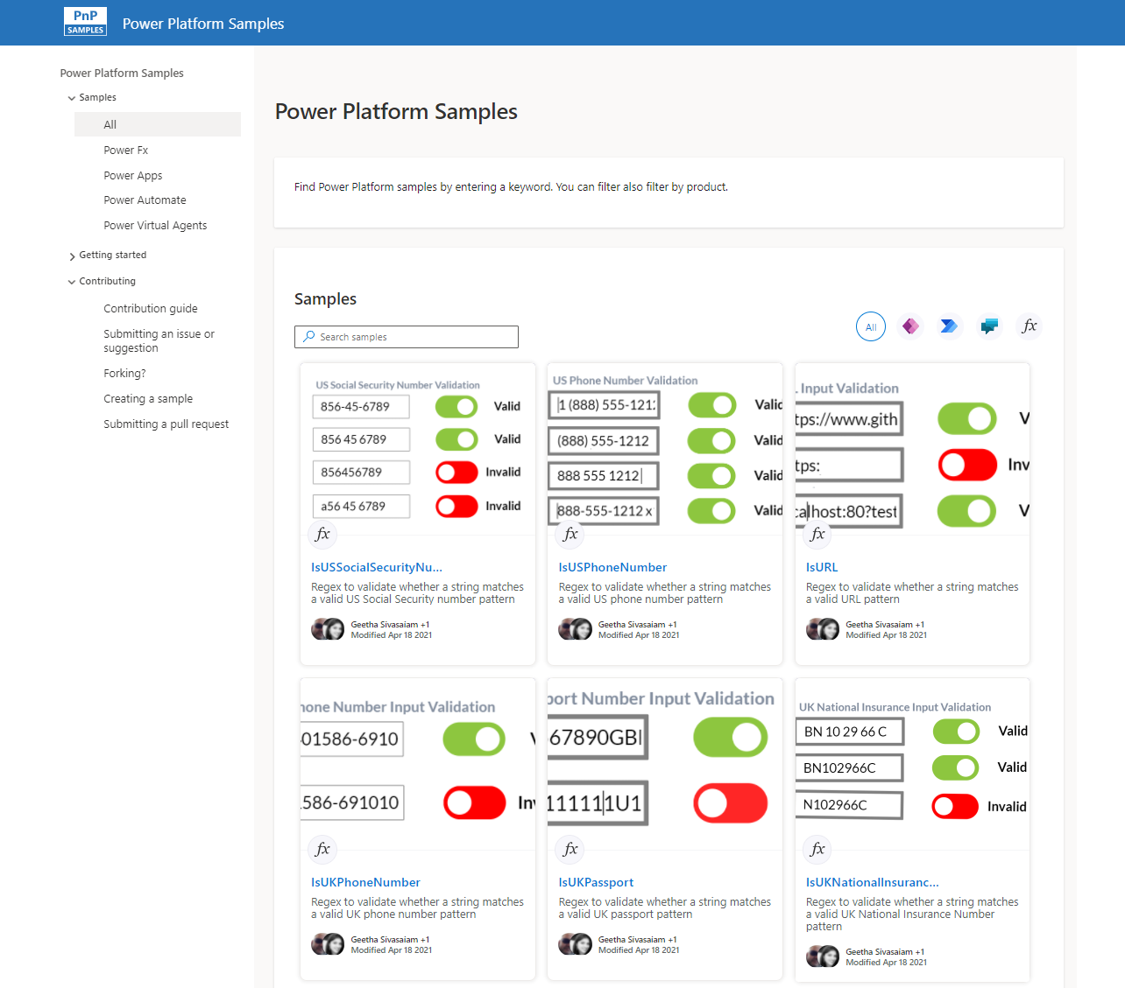
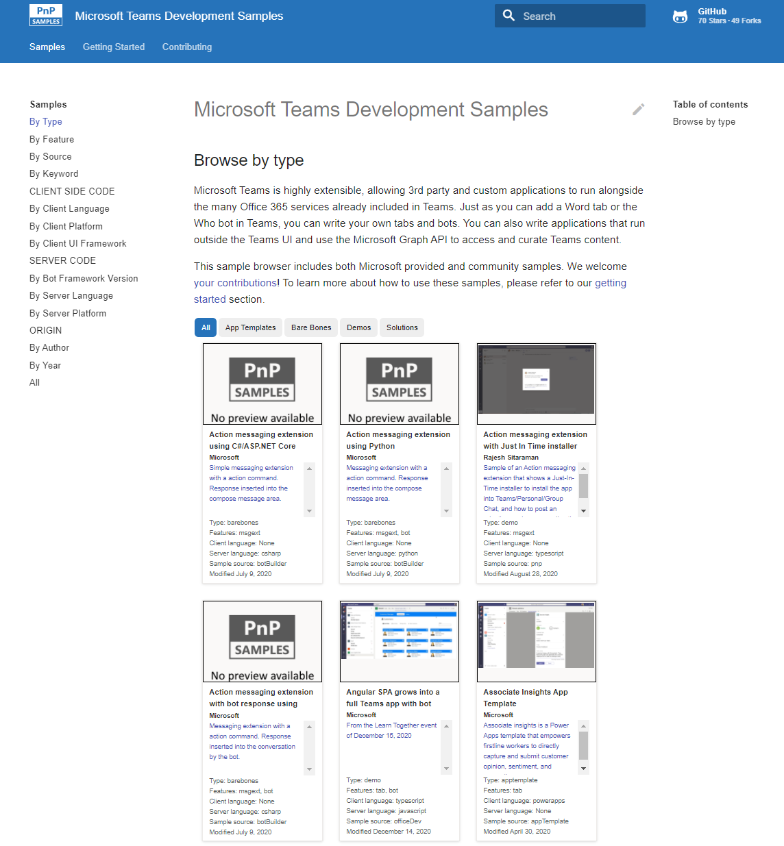
Microsoft 365 developer videos
Microsoft 365 community videos
Open-source
Sample galleries
Open-source initiatives and samples
github.com/sharepoint
github.com/pnp
github.com/officedev
github.com/microsoftgraph
aka.ms/m365/samples
aka.ms/teams-samples
aka.ms/spfx-webparts
aka.ms/powerplatform-samples
aka.ms/spfx-extensions
aka.ms/list-formatting
aka.ms/m365/community
aka.ms/m365devyoutube
aka.ms/m365pnp/videos
@Microsoft365Dev | @m365pnp

Slide 5
Microsoft 365 developer community calls
Microsoft 365 platform (weekly) https://aka.ms/m365-dev-call
(Notice. This call is on a summer break between July 1st and 31st of August 2022 – next call on 6th of September)
Adaptive Cards https://aka.ms/adaptivecardscommunitycall
Microsoft identity platform https://aka.ms/IDDevCommunityCalendar
Office Add-ins https://aka.ms/officeaddinscommunitycall
Power Platform https://aka.ms/PowerPlatformMonthlyCall
Microsoft 365 & Power Platform Development (bi-weekly) https://aka.ms/m365-dev-sig
Viva Connections & SharePoint Framework (bi-weekly) https://aka.ms/spdev-spfx-call
Download recurrent invites from
https://aka.ms/m365/calls
Notes:
m365-dev-sig

Slide 6
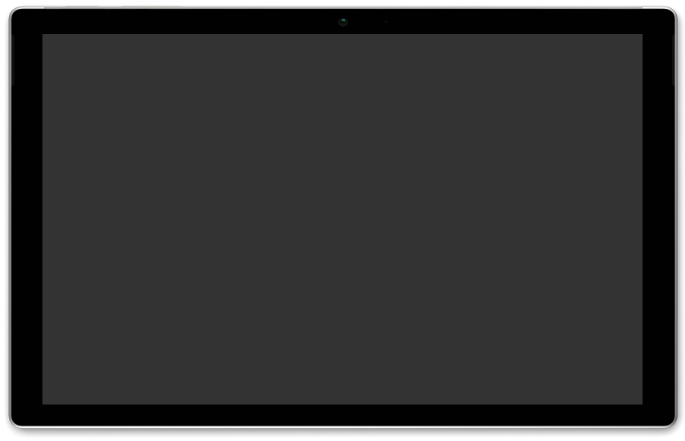
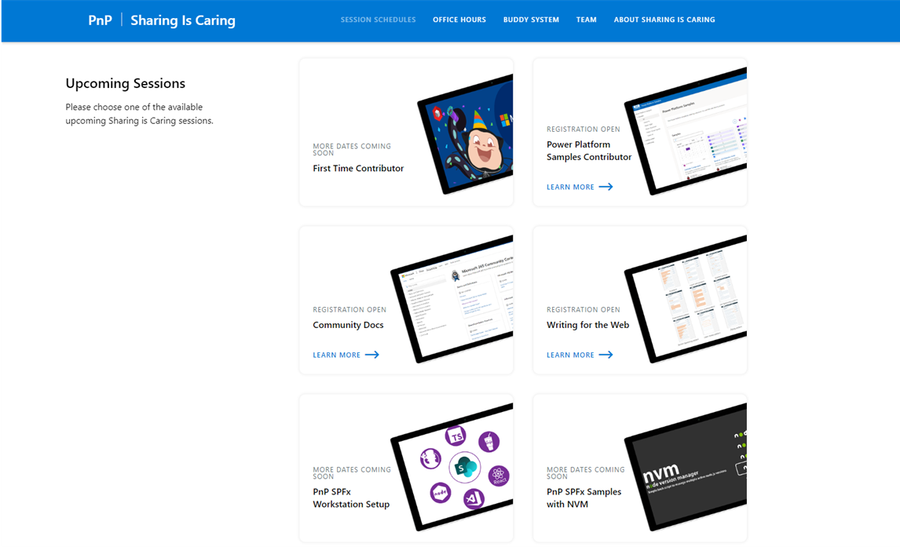
GUIDANCE
Learn how to get started in the open-source PnP community!
Upcoming Sessions:
First-time contributor
Power Platform Samples Contributor
Community Content Docs
SPFx Developer Workstation Setup
Using PnP SPFx samples w/ NVM
More than code with VS Code
First-time presenter
M365 Maturity Model Practitioners
Writing for the Web
Power Platform Samples Contributor
September Dates!!!
https://aka.ms/sharing-is-caring
Notes:
25 Total attendees, 16 attendees who attended both First-Time Contributors and Community Docs sessions.

Slide 7





COMMUNITY
PnP Recognition Program
Showcasing your contributions
Powered by Credly
More achievement levels coming soon
https://aka.ms/m365pnp-recognition
Notes:
25 Total attendees, 16 attendees who attended both First-Time Contributors and Community Docs sessions.

Slide 8
PnP .NET libraries A set of libraries that helps Microsoft 365 .NET developers to be more productive when working with SharePoint and Teams

Slide 9
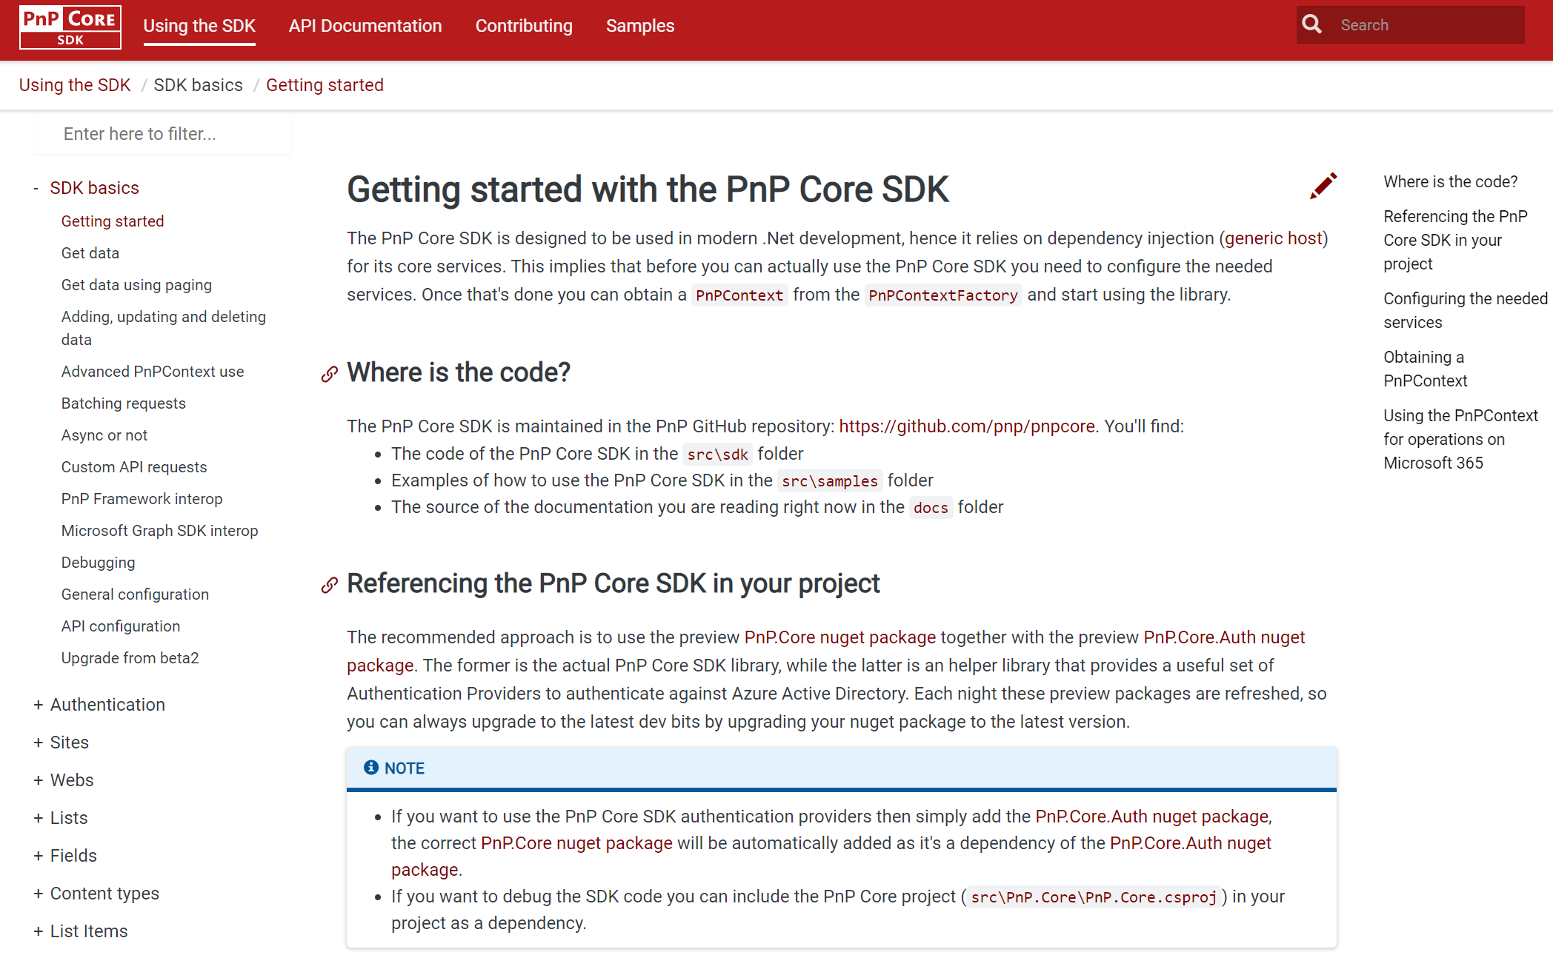
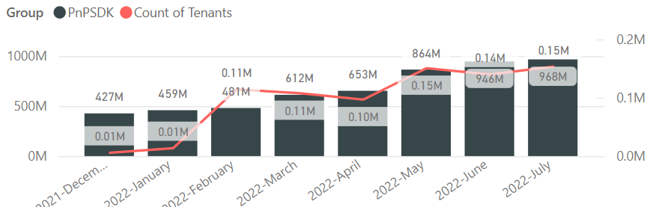
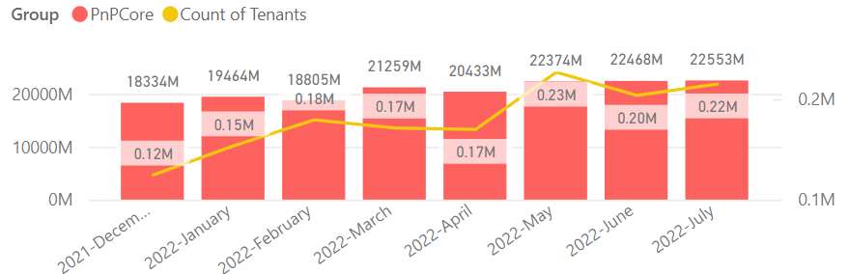

PnP .NET libraries
PnP Framework
PnP Core SDK
>220.000
Tenants in a month!
>687,000 downloads!
Prepping 1.11.0 (after summer break):
Merge pending PRs
Support for new SFPx Form Customizers for lists and libraries
General fixes and improvements: 👍 Gautam Sheth and Koen Zomers
>900,000 downloads!
Prepping for 1.8.0 (after summer break):
Support for using RefinementFilters: Llewellyn Roos 👍💪🚀
Getusereffectivepermissions support: Mathijs Verbeeck 👍💪🚀
Fixes and improvements: Bert Jansen 👍
Working on it
What key scenarios are still missing?
https://github.com/pnp/pnpcore/blob/dev/src/sdk/CHANGELOG.md
Roadmap
nuget.org/profiles/pnp
nuget.org/profiles/pnp
aka.ms/pnp/framework
aka.ms/pnp/coresdk

Slide 10
PnP PowerShell Open-source cmdlets which provide you an easy way to manage your SharePoint and Teams environment.

Slide 11
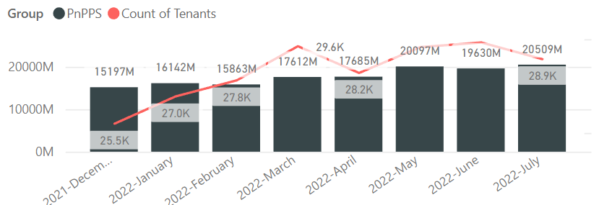

PnP PowerShell
Cross Platform PnP PowerShell
~29.000 monthly tenants!
V1.11.0 released, back from summer break Many updates, improvements and fixes!
2.7 million downloads!
100 million cmdlets executed per day!!
Docs shifted, no more docs.microsoft.com
Documentation, Articles and tips available at https://pnp.github.io/powershell
Thinking of dropping support for PS 5, any strong objections ???
PnP PS runs in PS 5, PS 7, Azure CloudShell, Azure Functions, Azure Runbooks & Raspberry Pi
New Stuff
1.11.0 released, nightly builds continue, go check it out
Minor documentation fixes, bug fixes and docs updates
Anything you would like to have in here ?
What next ? Would love to hear your thoughts !
Release: https://github.com/pnp/powershell/releases/tag/v1.11.0
Working on it
github.com/pnp/powershell
www.powershellgallery.com
PnP.PowerShell
https://github.com/pnp/powershell/blob/dev/CHANGELOG.md

Slide 12
yo teams Open-source Yeoman generator for Microsoft Teams development

Slide 13
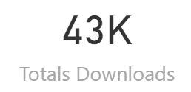
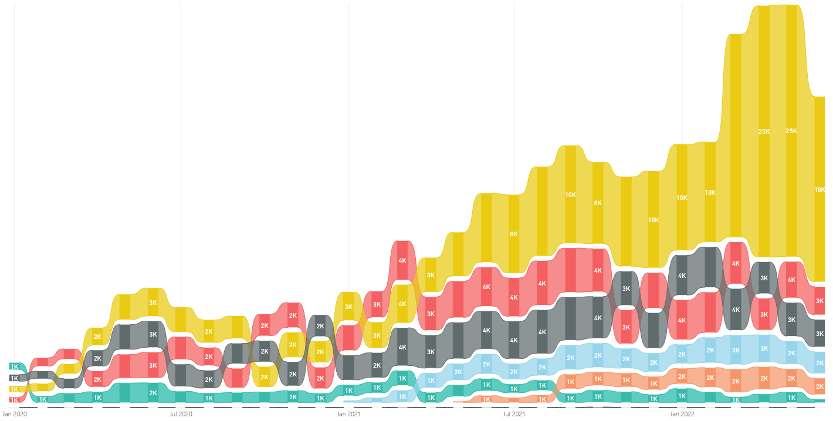
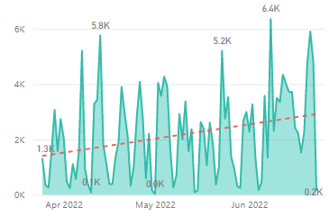
yo teams
V4 Released 🎉🎉🎉🎉
https://aka.ms/yoteams
generator-teams – The Teams apps generator
Package Downloads
📃 Docs published at https://pnp.github.io/generator-teams/
🚀 Latest release: 4.0.0 [2022-06-23]
Added `1.13` manifest Added `1.12` manifest Added `m365DevPreview` manifest Added component documentation for configuration and scaffolding details [Breaking] Upgraded Team JS SDK to version 2.0 (promises based) Updated all outdated references Manifest version 1.11 no longer selectable in scaffolding Default manifest version is 1.13 Added a warning regarding Connectors not working with Teams JS SDK 2.0 Calling bot support removed Viva Connections Tab scaffolding removed Removed individual component README files (available in Yo Teams docs) Fixed issue with telemetry timeout at the end of scaffolding
yoteams-build-core
yoteams-deploy
Daily build events
🚀 Latest release: 1.7.0 [2022-06-23]
Added support for Schema 1.13. Requires Node 14 or later Dependency package updates Fixed issue with telemetry timeout at the end of scaffolding
🔮 Preview: n/a 📅 Roadmap: ???
🚀 Latest release: 1.2.0 [2022-06-23]
Requires Node 14 or later Dependency package updates
🔮 Preview: : n/a
📅 Roadmap:
???

Slide 14
Microsoft Graph Toolkit Web Components powered by Microsoft Graph

Slide 15

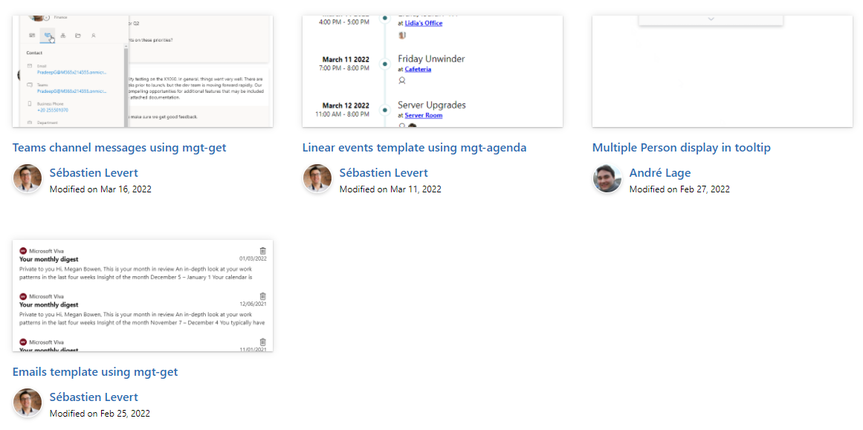

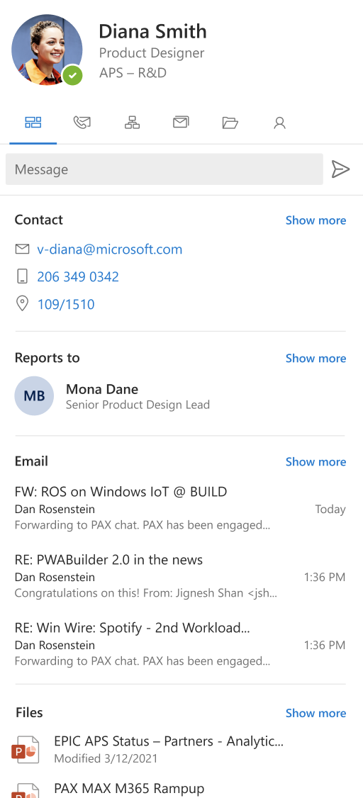
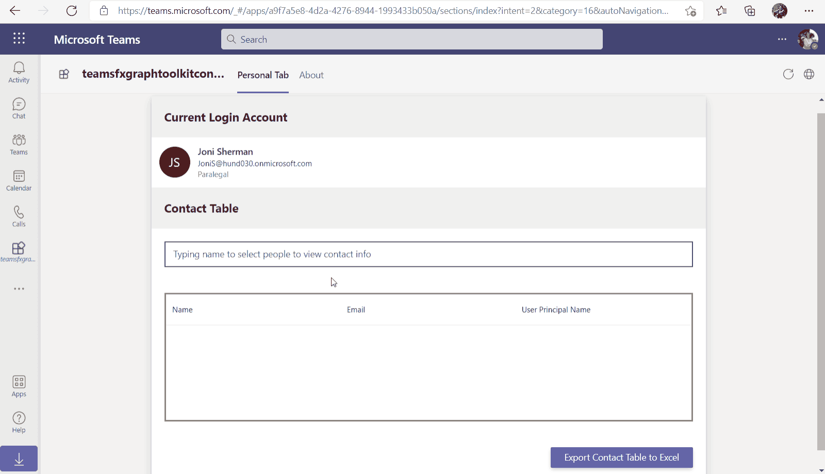
Microsoft Graph Toolkit
👀 More information: aka.ms/mgt
What’s new 🎉
V2.6.0 is our latest release! Update your packages! https://aka.ms/mgt/v2.6.0
Accessibility updates
Support for SPFx 1.15
Documentation on TeamsFx
Updates mgt-people-picker
Thanks @wuxiaojun514 for your contributions 🎉
The MGT samples repository is live! Keep your contributions coming! https://aka.ms/mgt/samples
What's next? 💻
Aligning all Toolkit components to Fluent UI Web Components
More generic components and theming capabilities
We need your help ❤️
🐞 Help us fix bugs
🆕 Help us build/improve features
help-wanted & good-first-issue -> https://aka.ms/mgt/issues

Slide 16

Independent Publisher Connectors
What’s new
53 Awesome Independent Publishers!
166 Independent Publisher connectors!
Updates to existing connectors:
Troy Taylor- Square Business
Troy Taylor- Square Payments
We need your help
Become an Independent Publisher by building one of these connectors: Top Connector Asks · microsoft/PowerPlatformConnectors Wiki (github.com)
OR
By adding more functionality to one of the existing Independent Publisher connectors on the Power Platform

Slide 17
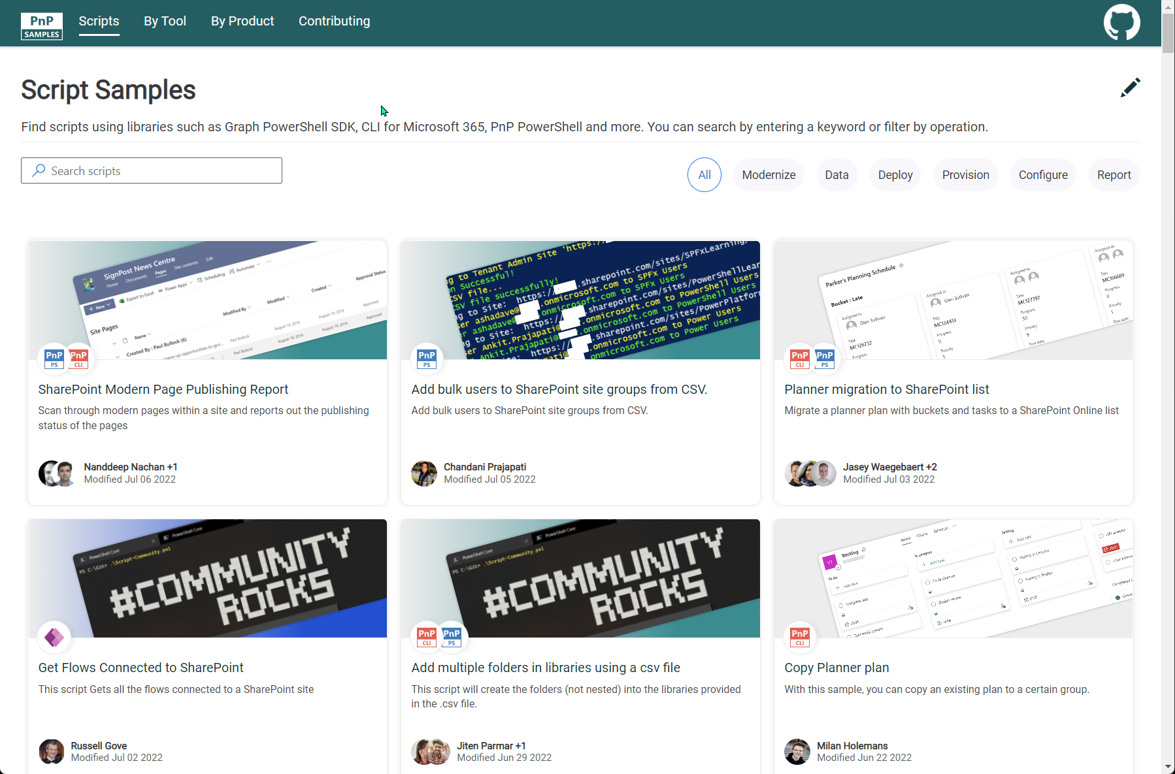



SCRIPT SAMPLES
One centralized location for all scripts for helping your day-to-day life. Contribution's welcome!
Site now has 164 scenarios and 249 scripts, using Microsoft Graph, CLI for Microsoft 365, PnP PowerShell, SPO Management Shell tooling and more…😁 AND samples integrated into "Unified" Solution Gallery
Awesome 🤩😃🎉👏 Samples Include :
New scenario using PnP PowerShell
Export checked-out files in all sites associated with a hub site to CSV by Arash Aghajani
Restore large number of items from SharePoint Recycle bin in bulk by Paul Matthews
Request Reindex of SharePoint User Profile Properties by Todd Klindt
Create a SharePoint site using the configuration of another site by Lewis Baybutt
Bulk Publish Syntex Models To Libraries by Leon Armston
Update web part properties on modern pages by Ramin Ahmadi
New scenarios using CLI for Microsoft 365 Scripts
Get Azure AD app permission info by Michaël Maillot
Updated Scenarios with PnP PowerShell Scripts
Add a document library web part to a page by Todd Klindt
Request Reindex of SharePoint User Profile Properties by Todd Klindt
Copy Planner Plan by Reshmee Auckloo
Site Feature: Now filter scripts used for security and permissions
Thank you for your samples and contributions – your awesome and happy summer holidays!
Ramin Ahmadi
Martin Lingstuyl
Reshmee Auckloo
Todd Klindt
Leon Armston
Paul Matthews
Lewis Baybutt
Ramin Ahmadi
Arash Aghajani
👏
aka.ms/script-samples
good first issue
We have good firsin the GitHub Repo with sample ideas of scripts that you could contribute to ☺ https://github.com/pnp/script-samples

Slide 18




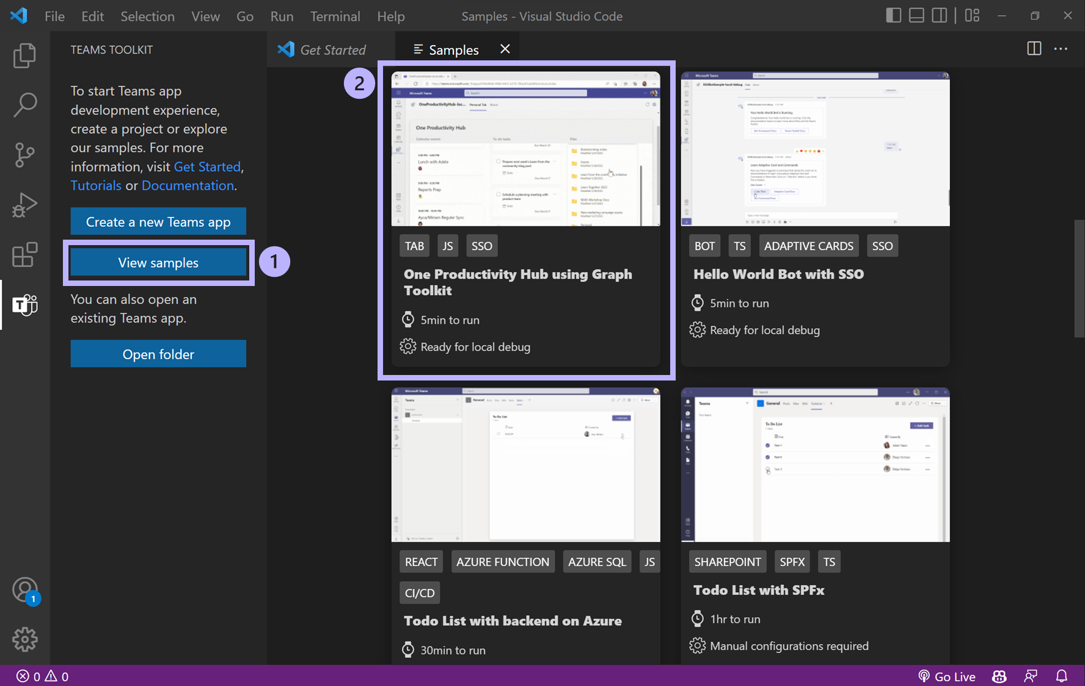

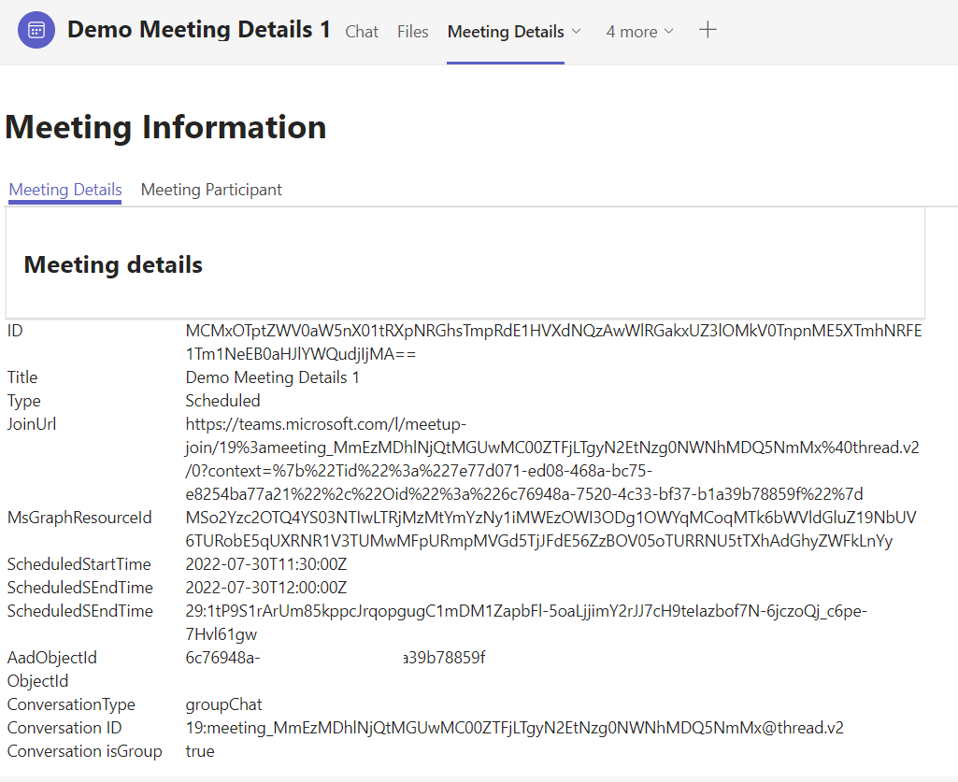
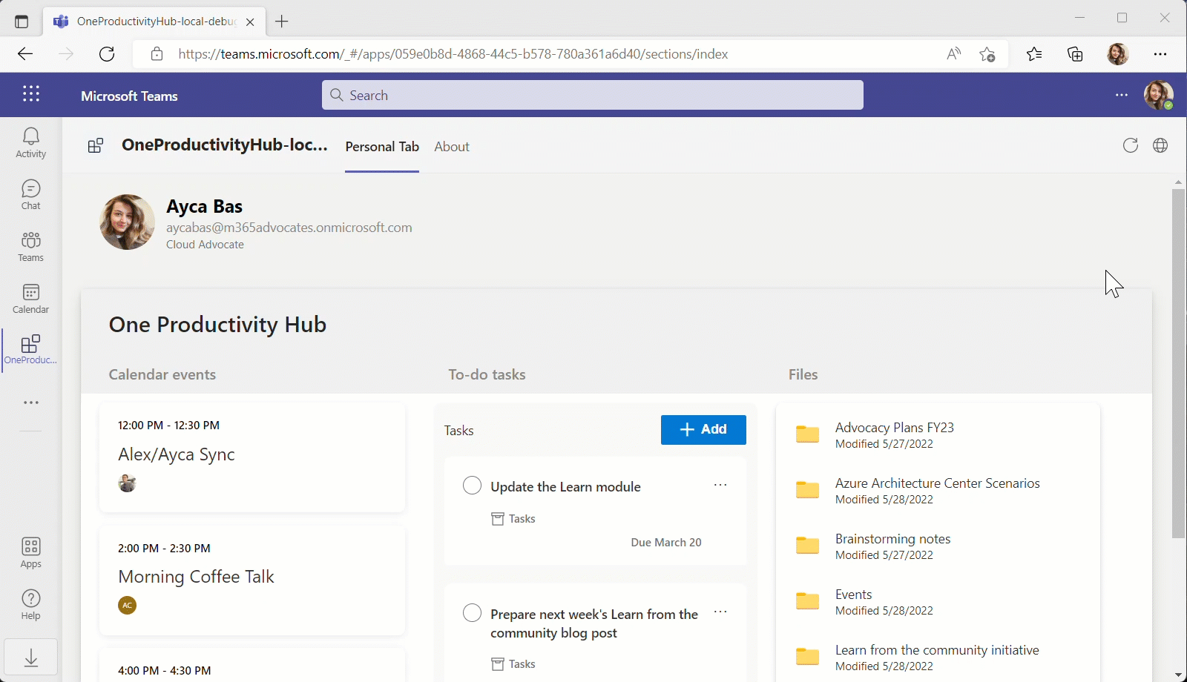





Microsoft Teams Samples
Please check out all the samples! https://aka.ms/m365-samples
https://aka.ms/teams-samples
New Teams Toolkit sample
Teams Meeting Details
Volunteers Needed!
SAMPLES WANTED!
One Productivity Hub - view calendar, to-do tasks and files using Microsoft Graph Toolkit components and TeamsFx Provider
Ayca Bas @aycabs
https://aka.ms/teamsfx-one-productivity-hus
Teams Meeting Details – shows how to use a bot to obtain details about the current meeting and participant
Markus Möller @Moeller2_0
https://aka.ms/tab-meeting-details
Check out all the samples! https://aka.ms/m365-samples
Teams samples w/filtering https://aka.ms/teams-samples
Notes:
Wajeed Shaikh – Teams PM

Slide 19

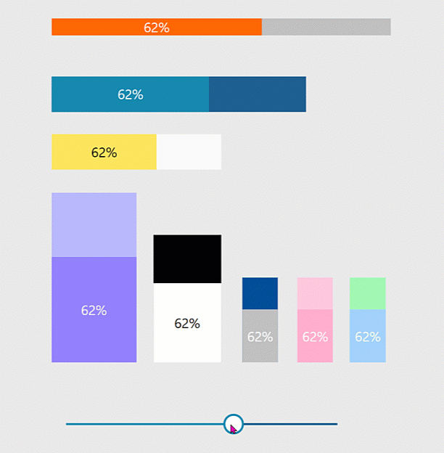
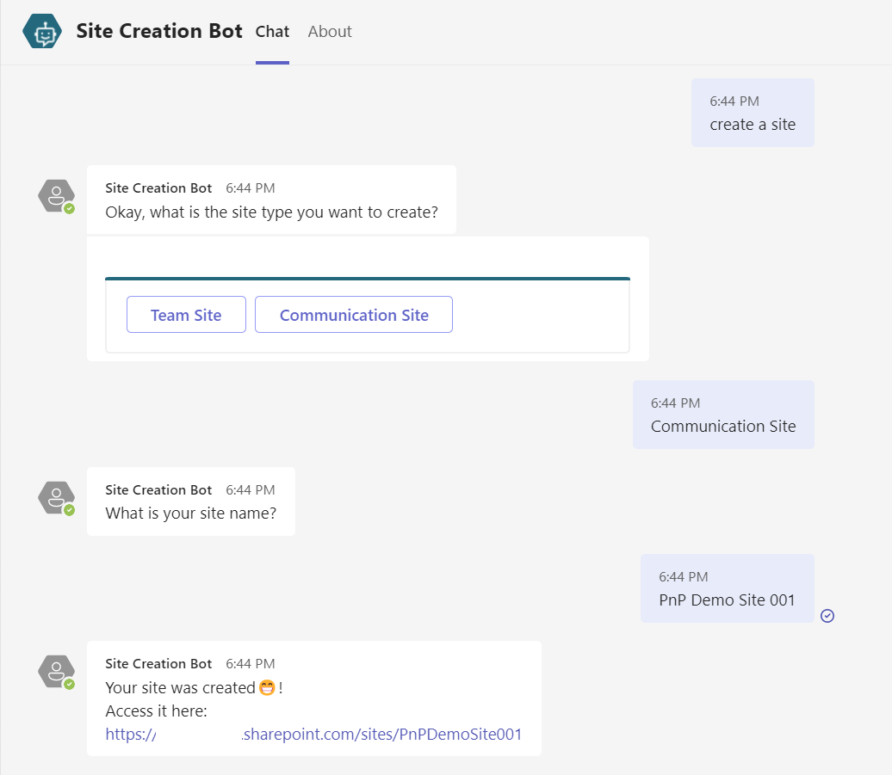



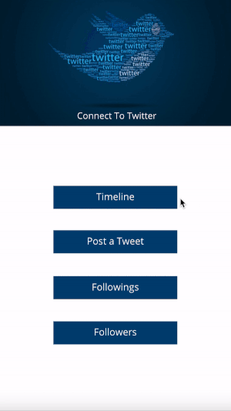
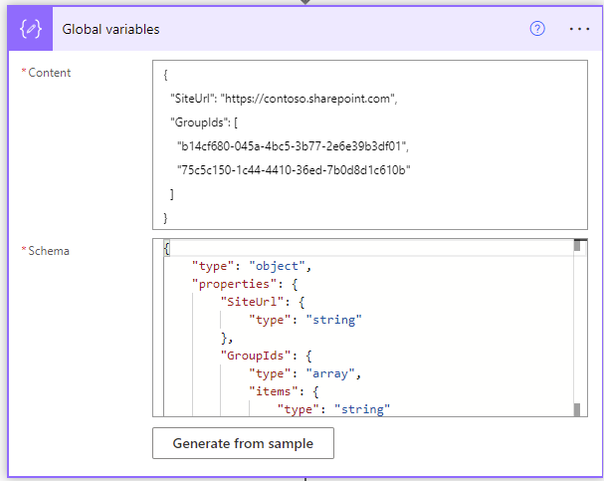

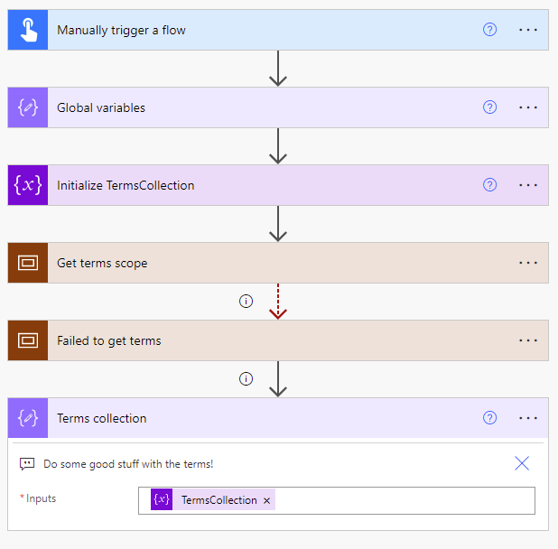
Power Platform Samples
New:
Progress-Bar Components Luise Freese | @LuiseFreese
Twitter Connection Lama Alluwaymi | Lama-alluwaymi
Get terms from Term Store Ramin Ahmadi | @raminahmadi1986
SharePoint Site Creation Bot Michel Mendes | @michelcarlo
aka.ms/powerplatform-samples ​
Notes:
These are the updates that we processed since out last call.
New samples:
- Power Automate: SharePoint Collect Feedback April Dunnam | @aprildunnam Demonstrates:
Executing a Flow from a SharePoint Library with input parameters
Leveraging the custom responses option in Power Automate approvals
https://github.com/pnp/powerautomate-samples/tree/main/samples/sharepoint-collect-feedback
- Power Automate: Get Graph API Data within Power BI Reports Scott McKenzie | @365EDUBI Enables Graph API data to be refreshed within the Power BI Service. https://github.com/pnp/powerautomate-samples/tree/main/samples/graph_api_in_power_bi
Updated samples:
Power App: Fluent UI Custom Theme Fabio Franzini | @franzinifabio Fixed datepicker control theme https://github.com/pnp/powerapps-samples/tree/main/samples/fluentui-custom-theme
These latest samples should show within 24 hours

Slide 20


Optional picture time!
Video on and we’ll grab a Together Mode pic with those who are willing to do this.
We are together on this as a community!
By enabling your camera for the picture, you’ll give us the permission to share your picture in social media.

Slide 21
DEMO
Independent Publisher Connectors - RegEx Matching Demo – Mitanshu Garg
List Formatting Magic - Data and Time formatting options – Chris Kent

Slide 22

Q&A

Slide 23
Thank you
Recording will be available in 24 hours on
Microsoft 365 Community (PnP) YouTube channel
https://aka.ms/m365/videos
(subscribe today)
Follow us on Twitter
@Microsoft365Dev | @M365PnP
Next M365 General Dev call: September 1st at 07:00am PT
Next Viva Connections & SharePoint Framework call: August 25th at 07:00am PT
See all other community calls from https://aka.ms/m365/calls

Slide 24



Slide 25
Thank you

